Slide 1
A Project for Cleaning the World
Seedstars Bogotá 2015

Slide 2
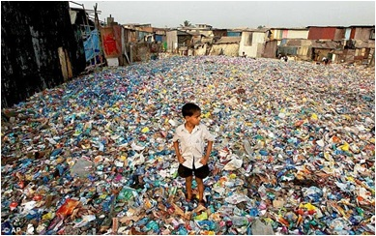
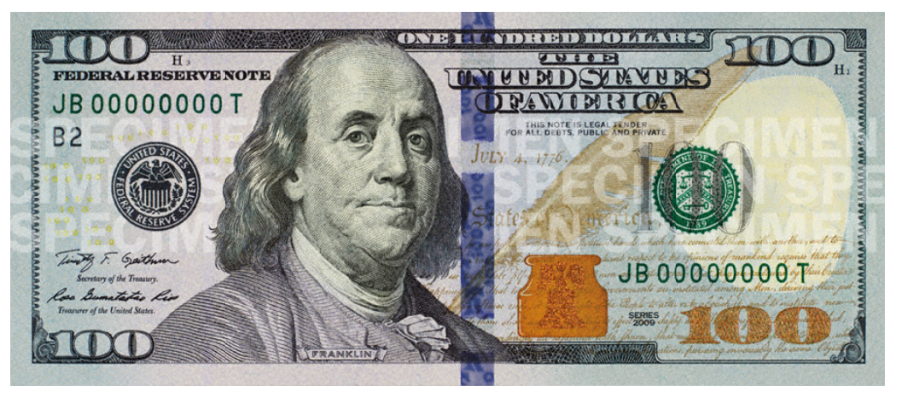
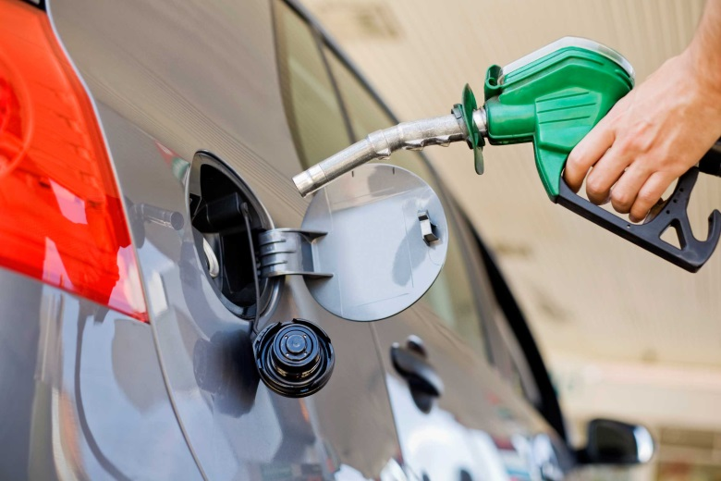
We turn waste plastics into money by making motor fuels out of them.

Slide 3
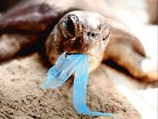
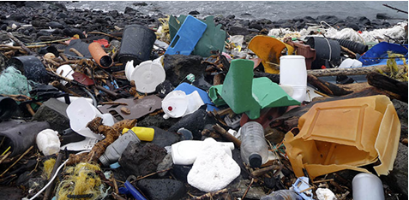
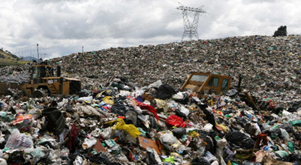
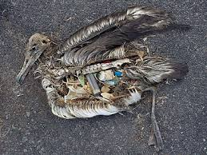
Are you tired about having waste plastics all arround?

Slide 4
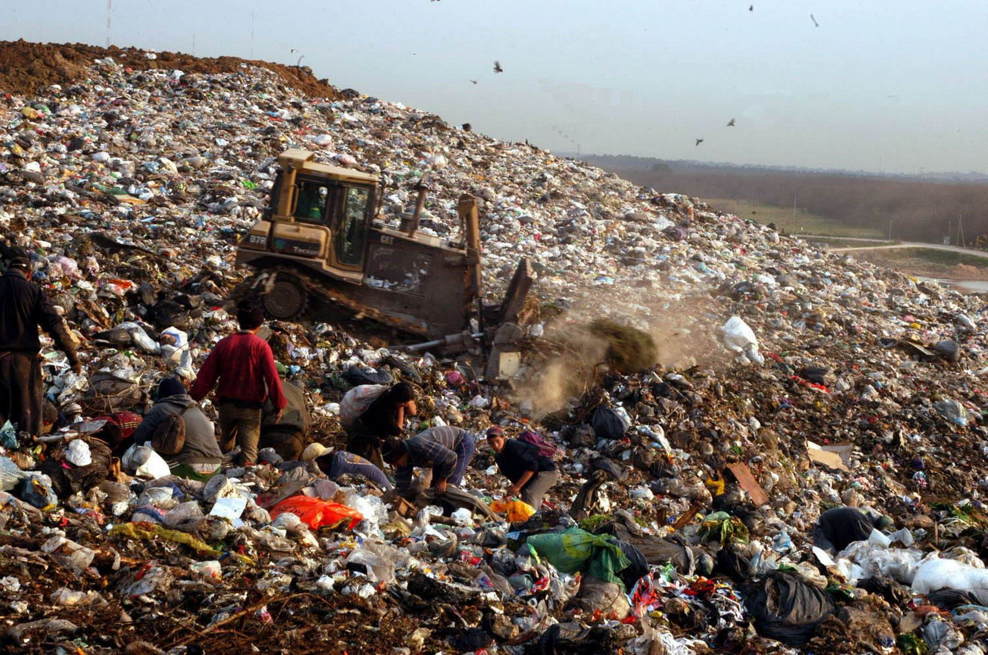
The pain of our Customers.
The extended environmental Responsibility

Slide 5
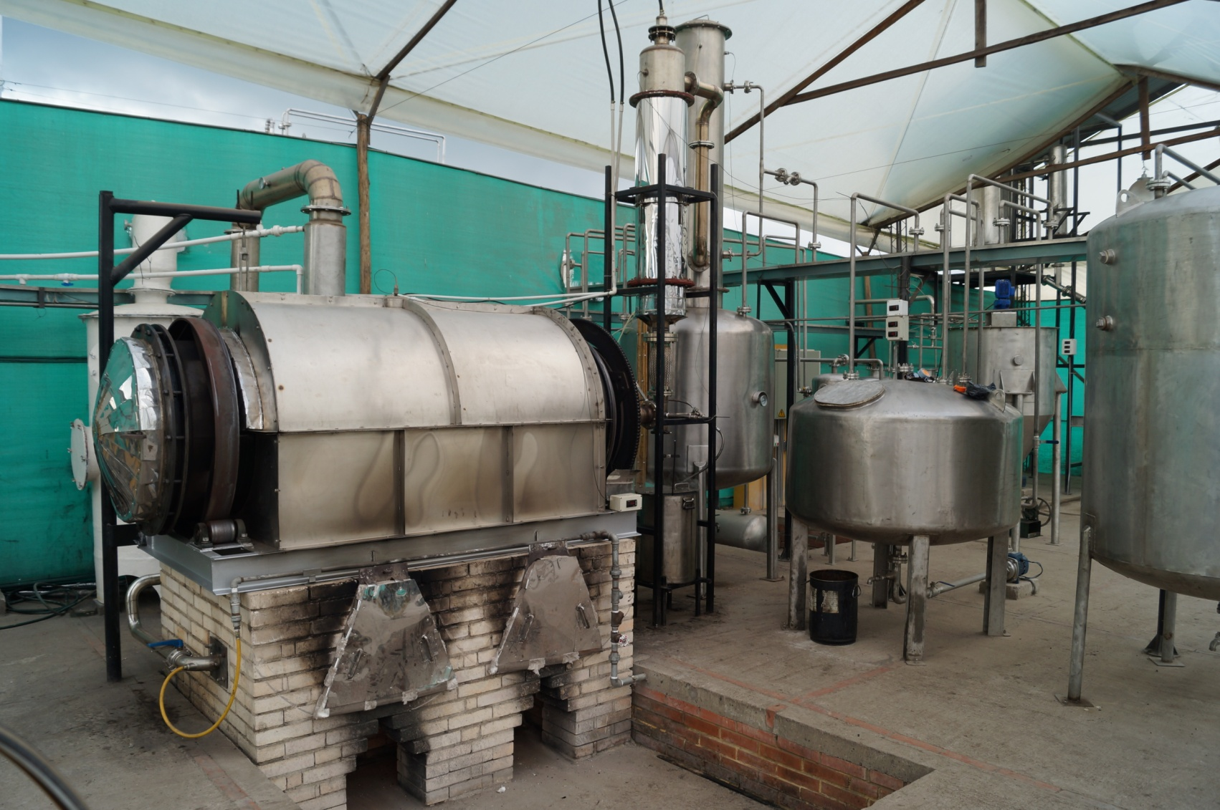
Our Solution
Valuing non recycable
waste plastics trough an
Eco friendly process

Slide 6
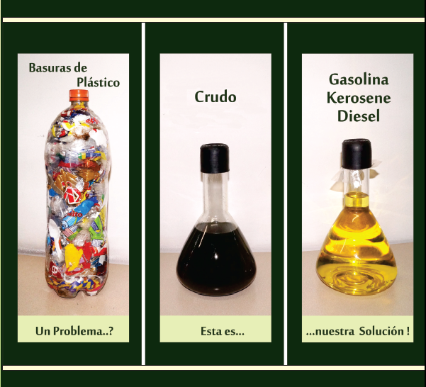
1 kg Plastic = 1 lt Light Crude Oil
35 % Gasoline, 40 % Diesel Oil

Slide 7
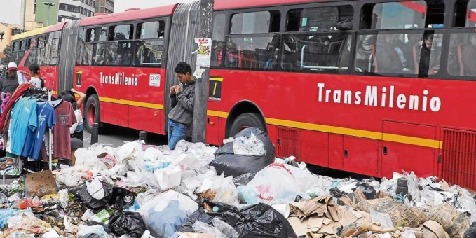
Only in Bogota
7000 ton/day Total wastes.
10 % Plastic waste
700 ton/day
140 Plants of 5 ton/day
140.000 gal/day.
USD $ 350.000/day
USD $ 84.000.000 per year.

Slide 8
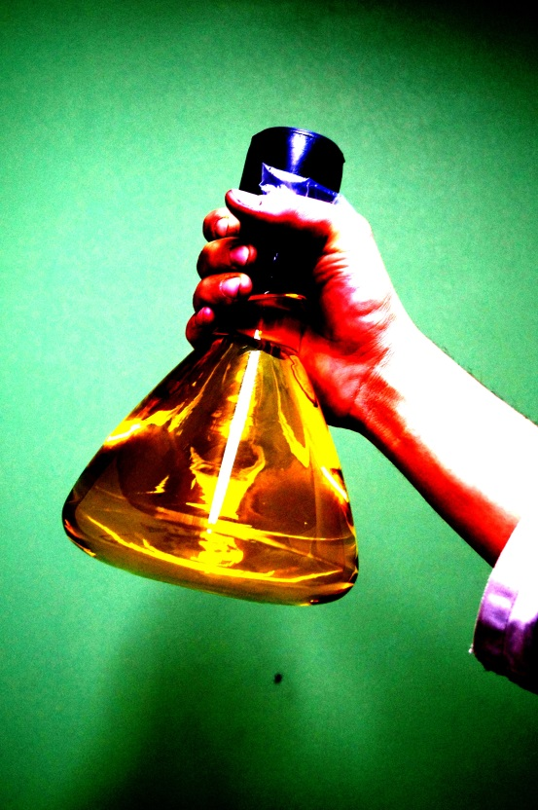
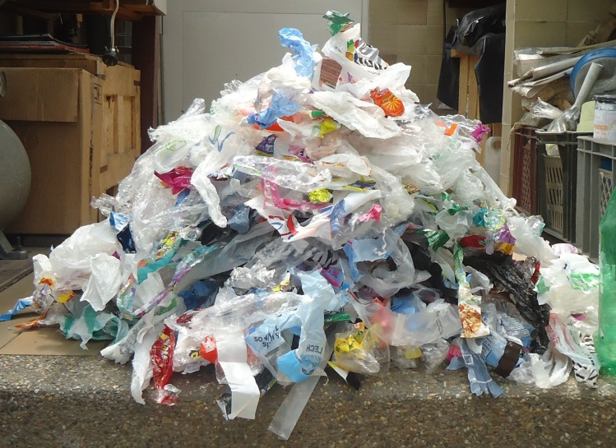
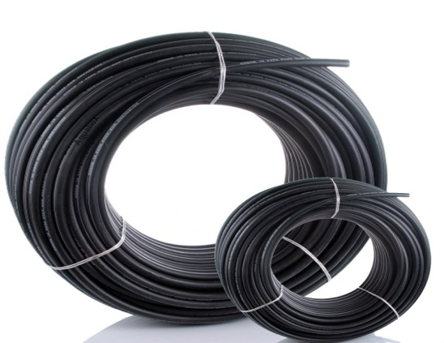
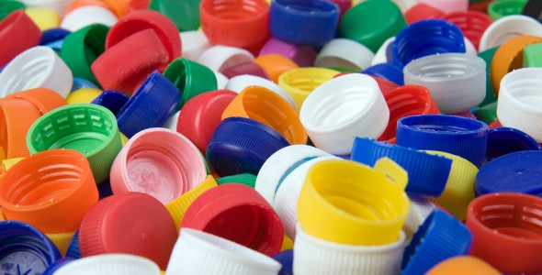
Competition
What we do
What They do

Slide 9
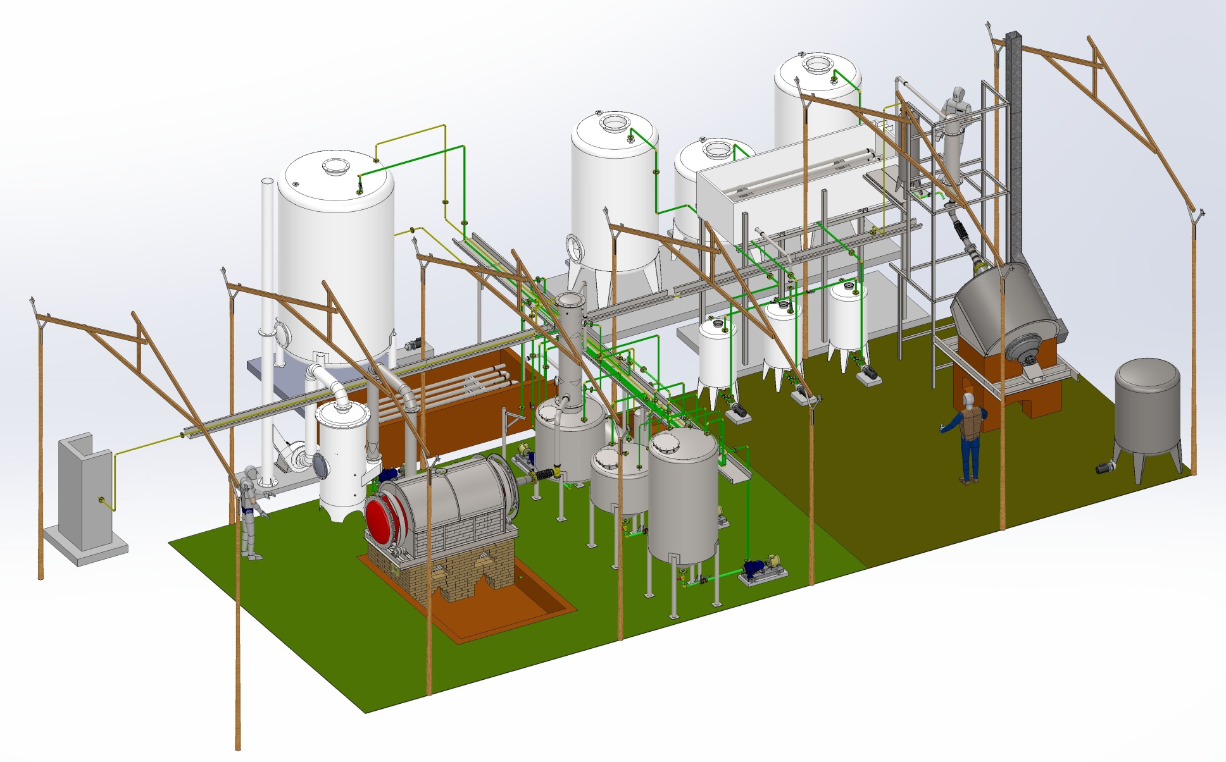
Our Product.
Our product is an environmental solution to problems such as the disposition of non recyclable plastics.

Slide 10
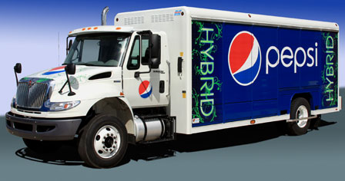
We produce motor fuels
at half the market’s
retail price

Slide 11
Current Status
Scaling Path
5.000 kg
250 kg
1,5 kg
Total Invested in Pilot Plant
USD $ 300.000

Slide 12
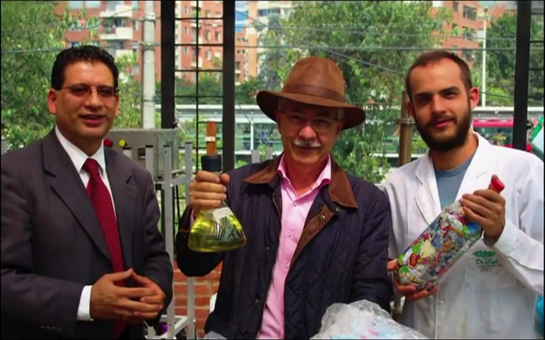
Our Team
Gustavo Salazar Molina. Felipe Calderón Sáenz. Pablo Calderón Tobón.
Commercial Director CEO Plant Director

Slide 13
Actual Needs
Investment …………. USD $ 1.000.000
Strategic Partners for up and down stream development.
With your help and guidance we will make our dream come true.

